Slide 1
Instructions for crediting external courses in Wilma

Slide 2
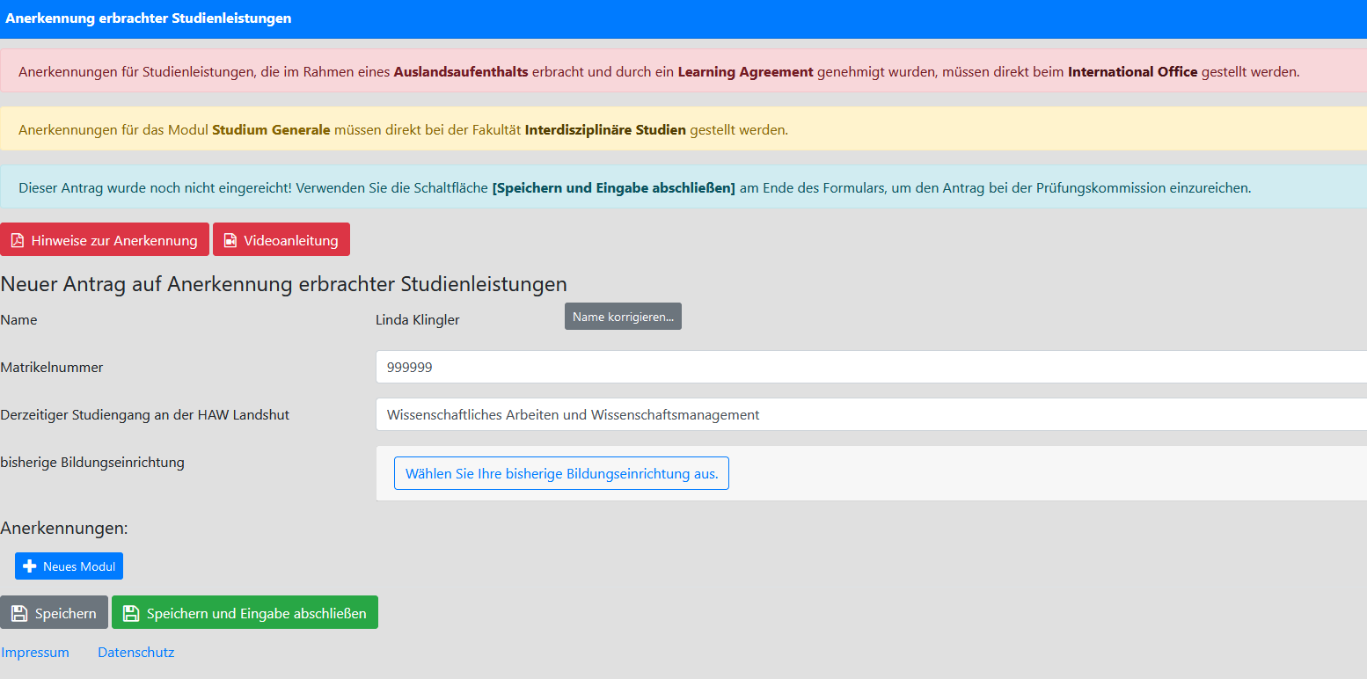
    Log in with your student account (https://portal.etwi.haw-landshut.de/login/?next=/opal/)
    „Anerkennung von Leistungen (OPAL)“
    Insert student ID number
    Start new application
    „Derzeitiger Studiengang an der HAW Landshut“
    Wissenschaftliches Arbeiten und
    Wissenschaftsmanagement

Slide 3
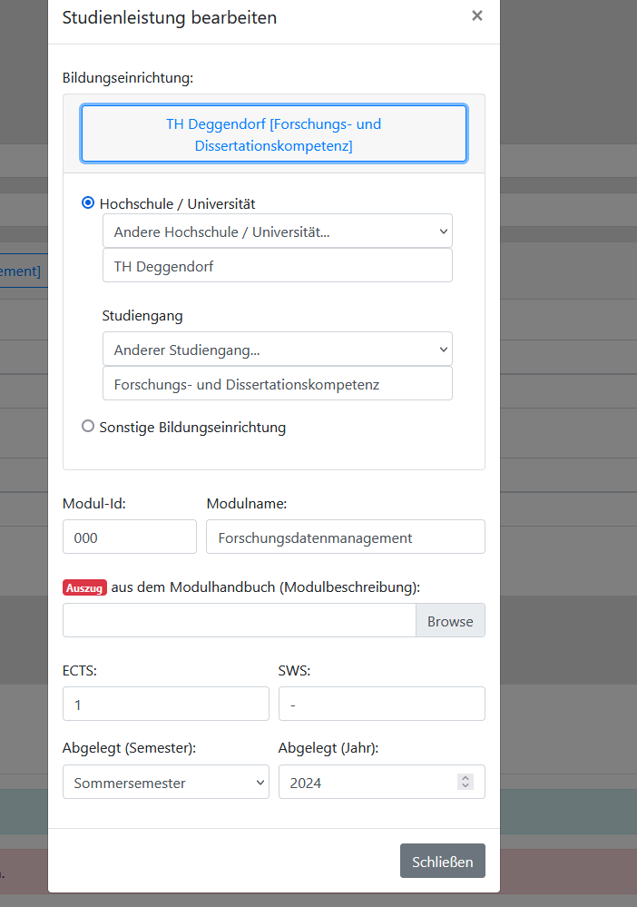
    Insert „bisherige Bildungseinrichtung“ (e.g., TH Deggendorf) and
    „Studiengang“ (e.g., Forschungs- und Dissertationskompetenz)
    Choose a new module
    Add completed coursework „(+Neu)“
    Fill in the relevant data if you want to credit a course completed at
    a university (of applied sciences)
    a. If no module number exists (because there is no module handbook),
    simply use any module number
    b. Add excerpt from the module handbook or course description
    (e.g., add a screenshot of the homepage with a description and ECTS credits)
    c. If SWS < 1, insert „–”
    d. Specify semester and year

Slide 4
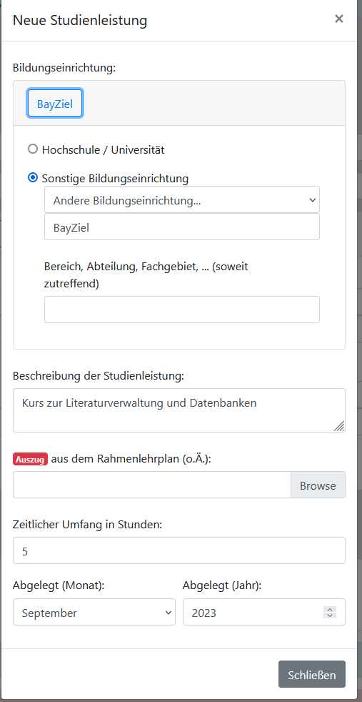
    Fill in the relevant data if you want to credit a course completed at another educational institution
    a. Provide an informative description of the coursework
    b. Add course description excerpt
    c. Specify the duration in academic hours
    d. Specify month and year
    Save entries (not yet submitted)

Slide 5
PLEASE NOTE: Credit for the "Good Scientific Practice" course at Landshut University of Applied Sciences
    Please have this credited for the “Basics of scientific work" course
    To do this, select "HaW Landshut" as the educational institution (“Bildungseinrichtung”)
    Please select “anderer Studiengang” as “Studiengang”. Enter “Kurs externe Dozierende” in the new field
    Fill out as usual and save the entry

Slide 6
    Once everything is completed, select “speichern und Eingabe abschicken" → the application is sent
    If the credit transfer is approved, send the proof (e.g., certificate of attendance) to Carola Fien (studienbuero_et@haw-landshut.de)
    The approval is then entered into Primuss by the Student Office
    A new application is required if you want to credit a coursework from a new previous educational institution

